Slide 1
PROJECT DISCUSSION
Final year Project Phase-2
Project Guide
Dr. T V RAJINIKANTH
BATCH 4
G SRI NITHIN (18311A05K4)
CH S C A RAMA GANESH (18311A05J9)
SHEKKARI AKSHAY (18311A05N9)

Slide 2
Project Statement
Building a model that forecasts store sales by analyzing time series data

Slide 3
BRAIN STORMING IDEAS
Using ARIMA model
- Hyper Parameter Tuning using the GRID & RANDOM SEARCH
Using LSTM model
- Designing own sequential model using tensor flow
Using ARIMA – LSTM
- Combining the bagging technique
Using ARIMA – LSTM
-Combining using the Ada Boosting technique

Slide 4
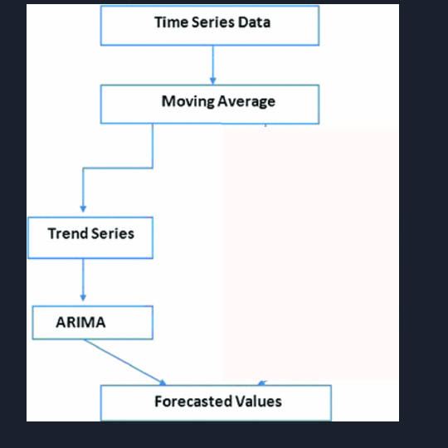
ARIMA

Slide 5
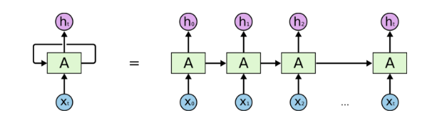
LSTM

Slide 6
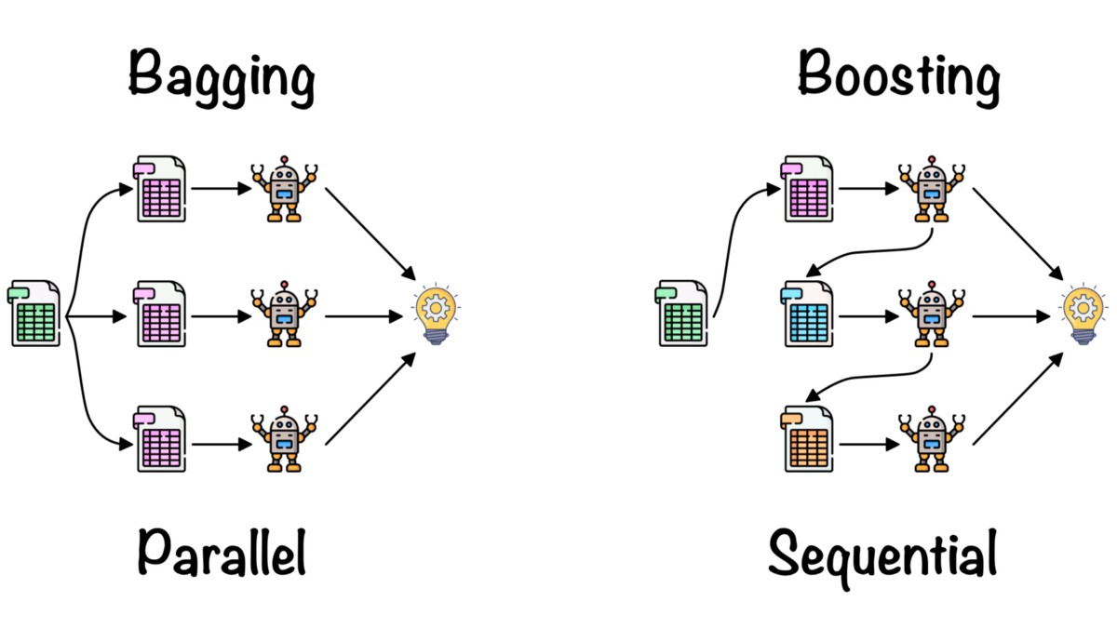
Bagging

Slide 7
Boosting

Slide 8
Thank you

